Slide 1
Control flow
We know that our program executes from top to the bottom, line by line
But what if you want to execute code, while excluding others, or you want to execute code based on some condition, if you want to do this we say you want to control the flow of the program

Slide 2
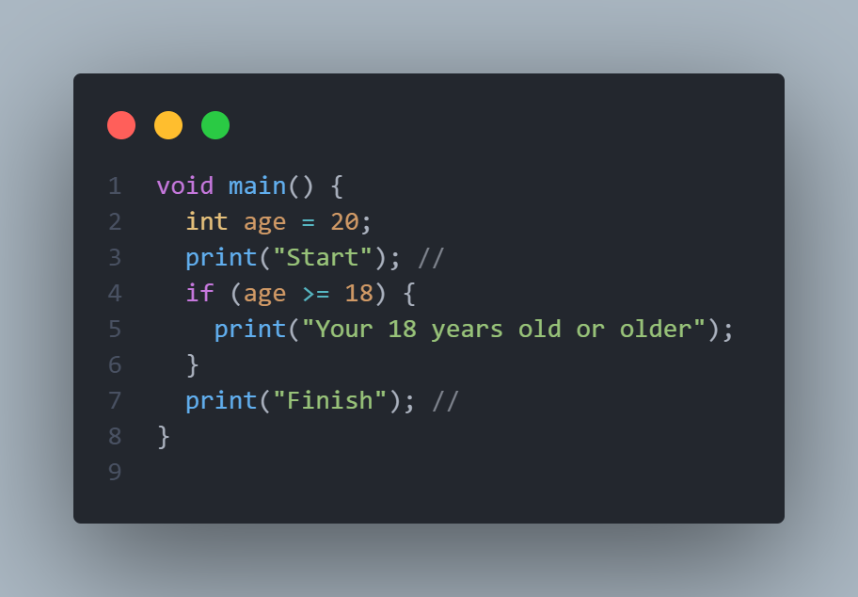
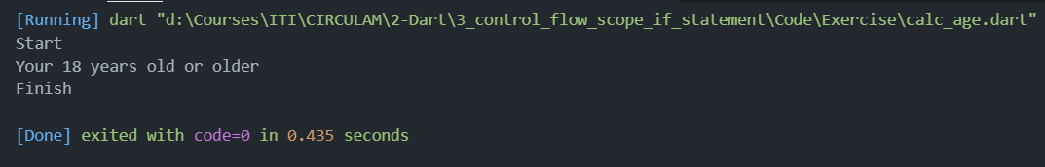
If
If the first tool at our disposal to control the flow of the program, say you want to print a message to the user based on his age,
We see that that all the print lines are executed

Slide 3

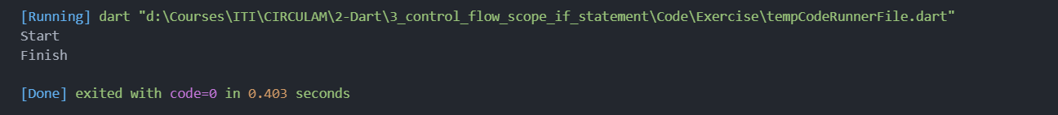
If statement
After changing the age to 15 the line inside the if statement isn’t executed
Line 5 is not executed
We conclude that the code inside the if statement executes if and only if the condition is true, if it’s false it’s not executed

Slide 4
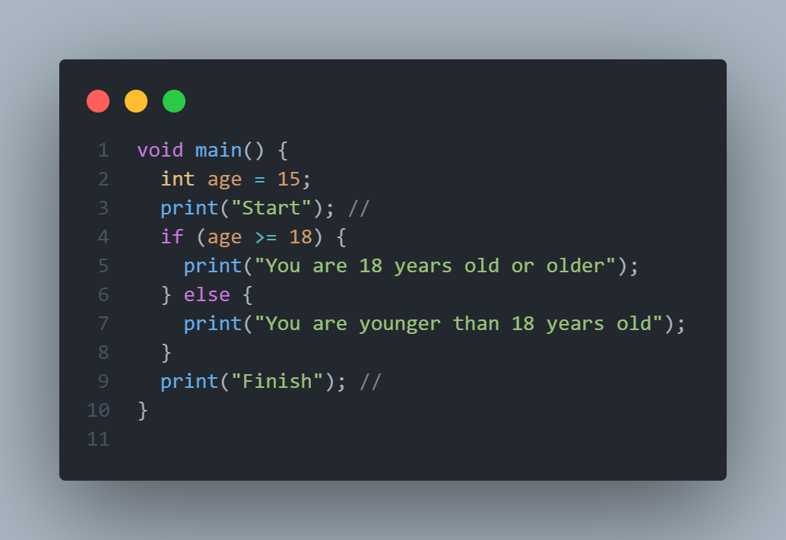
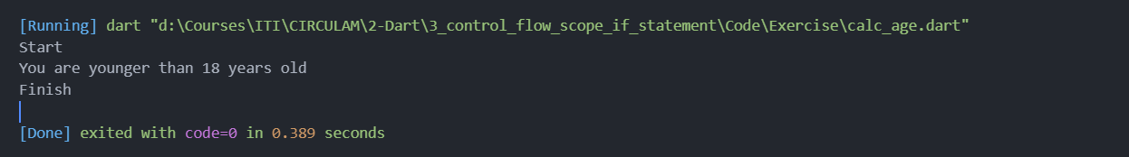
If-else statement
But what if you want to execute code if the condition is false?, in this case we use the if-else statment
We see that the condition inside if is false
So it will jump to the else immediately and
Executes line number 7

Slide 5
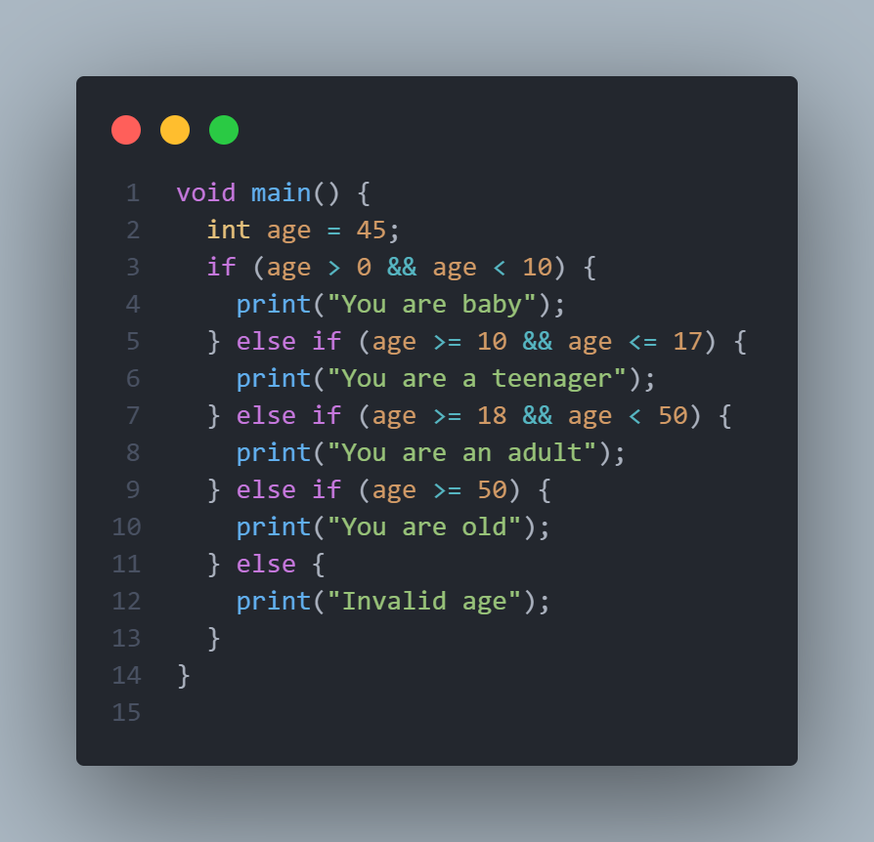
If-else if-else statement
Ok now let’s increase the flow our program, what if want to tell the is baby,teenager,adult or old
Meaning we have four cases, the else if comes int play here
The program goes as follows, is age greater than
Zero and less than 10, the condition is false, then skip
Line number 4.
Is age greater than or equal to 10 and less than or
Equal to 17, the answer is no or false, then skip
Line number 6
We see that condition number 3 on line number 7 is
True, then line 8 is executed

Slide 6
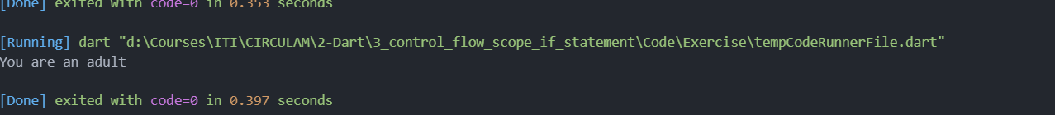
If-else if-else statement

Slide 7
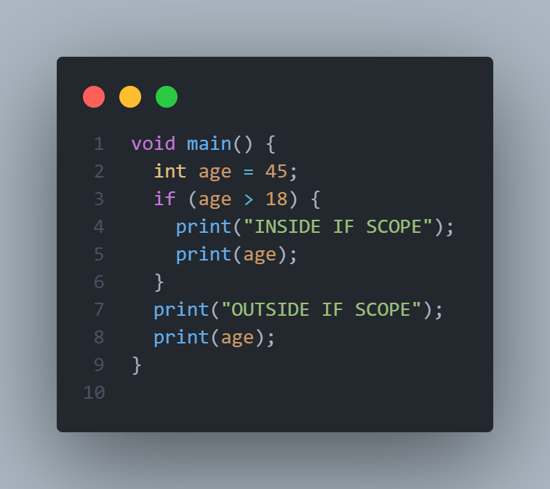
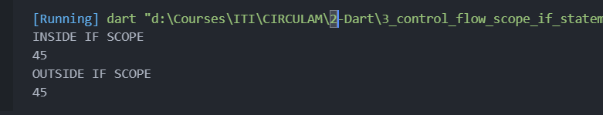
Scope and body of a code
We saw when we wrote our if statement, we put our code inside curly braces {}
And after that we can put our code inside these curly braces, the code inside the curly braces are called block of code, or this is the scope of if statement
We can clearly see that we can access age from inside
The if statement and from the outside, or we can
Access it from the if scope and the main scope

Slide 8
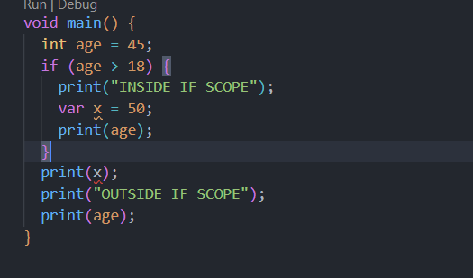
Scope and body of a code
But what if I define a variable inside the if statement, and try to access from the out side?
We define x inside the if scope, but we can’t
Call it from the outside of that scope?
What do we conclude from this code and the
Previous one?
the conclusion is that the inner scope can access variables defined in the outer scope but the opposite is not possible, meaning the outer scope or in that case the main scope can’t access the variable defined inside the if scope

Slide 9
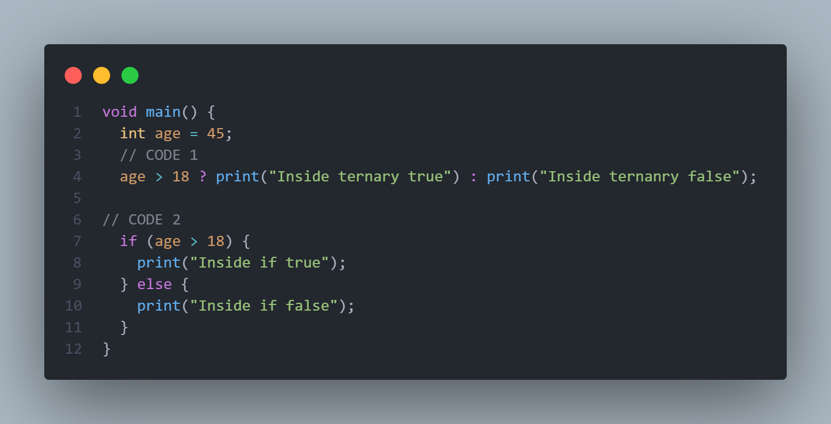
Ternary expressions
There is a shorthand way to write if-else statement, using what is called a ternary expression
Using ? :
The two codes are the same
The line before ? Is the condition
If that condition is met, the line after ?
Is executed
If the condition is not met, the line
After : is executed

Slide 10
Nested if
Wouldn’t be nice if you could put if inside an if statement?
In fact it is possible it’s called Nested If statements
suppose we have a program to determine if a user can ride a car or not, to be able to ride a car you must be greater than or equal to 18 years old and have a license
There are a more than one case, maybe less than 18, in this case we print a message saying you are still young, the user maybe 18 or more but has no license in that case we print a message saying you have to get a license, the happy case is that he is 18 and has license, let’s tackle this program using two different ways

Slide 11
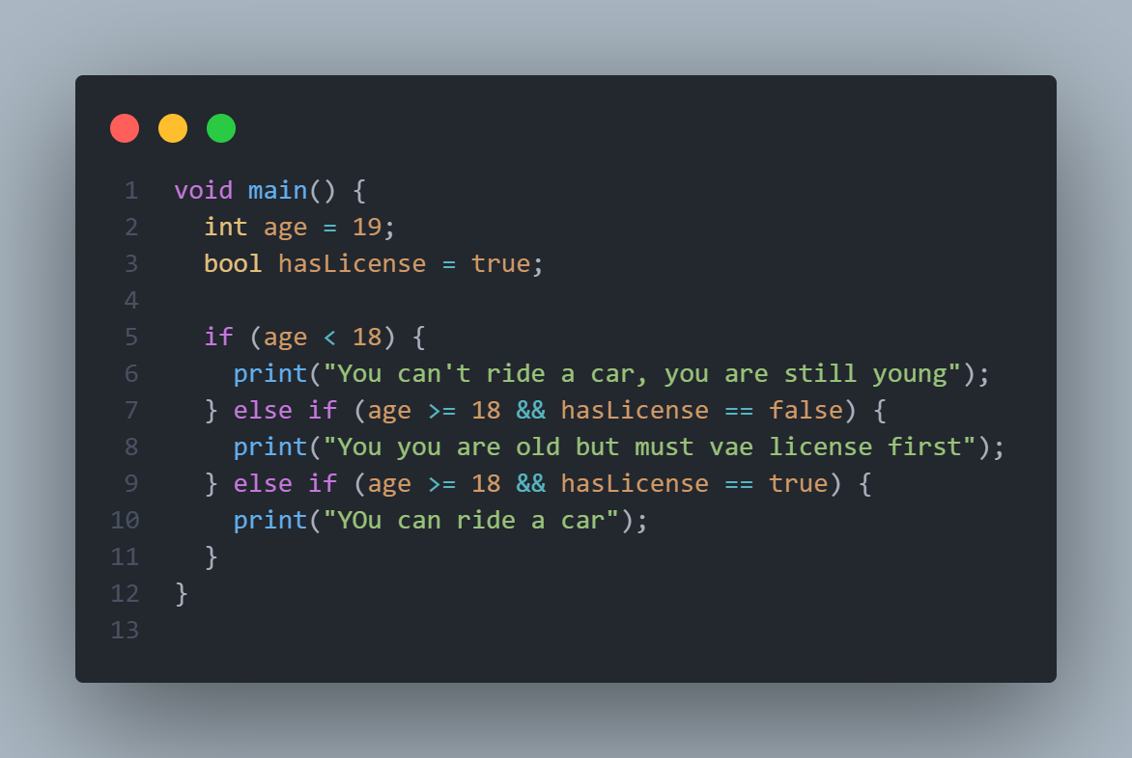
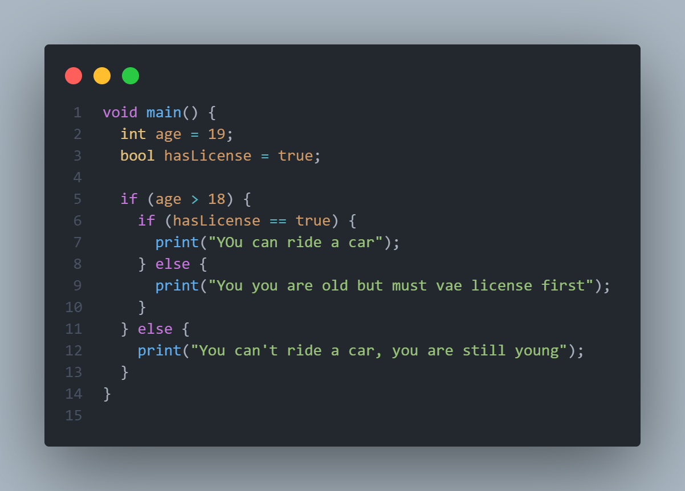
Nested if
Wouldn’t be nice if you could put if inside an if statement?
In fact it is possible it’s called Nested If
The two codes are the same, one using nested if on the right and one using normal if on the left

